Slide 1


Slide 2
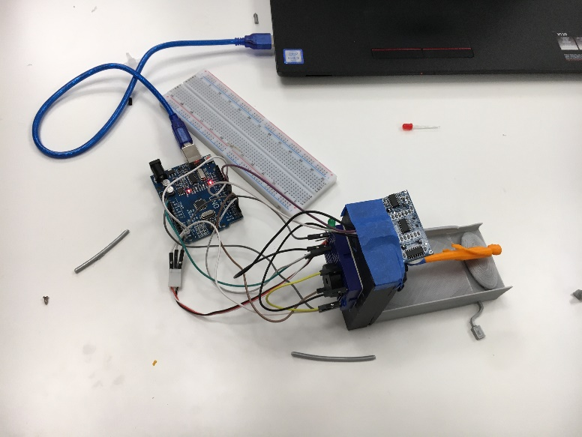
SWEET DREAMS
What we created
Our goal

Slide 3
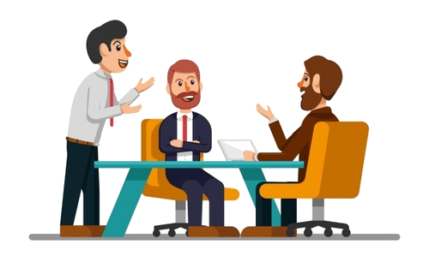
OUR TEAM
MAKERS
Henry Lawy and Tomer Tzoreff
DESIGNER
Eliane Moradi
Romina Yahya
ENGINEER
Alex Cambier
CODER
Leam Cohen

Slide 4
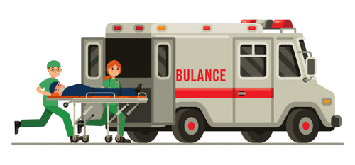
PRODUCT INFORMATION
Several chips integrated into mattresses
Calls the nearest hospital

Slide 5
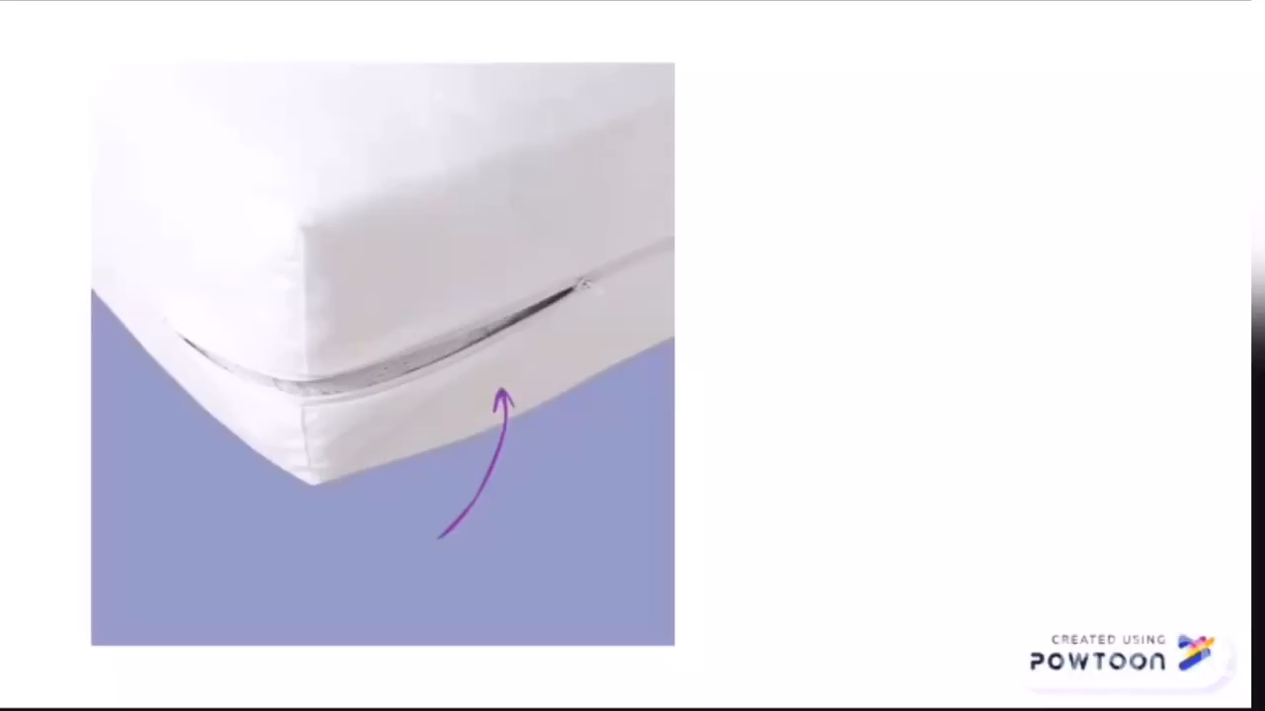
HERE’S HOW IT WORKS

Slide 6
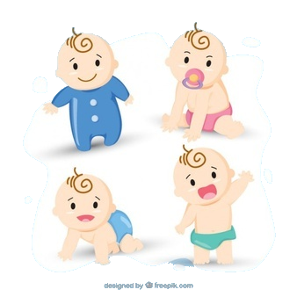
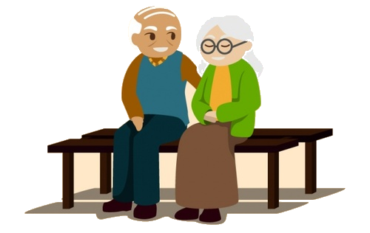
TARGET MARKET
Our product can be used by anyone, but it is especially designed for elderly people and children.

Slide 7

REVENUE MODELS
Positioning strategy: mattress manufacturers and mattress stores.

Slide 8
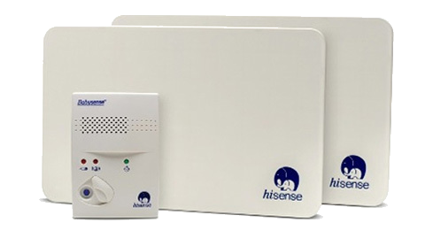
COMPETITORS
We are aware of a company called "Audioline" that holds the majority of this market.
What is the difference between our product and their product?

Slide 9
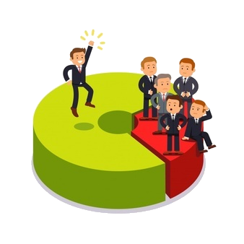
Differences compared to competitors
 | Babysense | Sweet Dreams
Target Market | Children | Children and elderly people
Technology | A video camera | Sensors, touchscreen
Emergency Response | No | Yes
Call System | No | Yes

Slide 10
PREVENTION IS BETTER THAN CURE.

